Slide 1
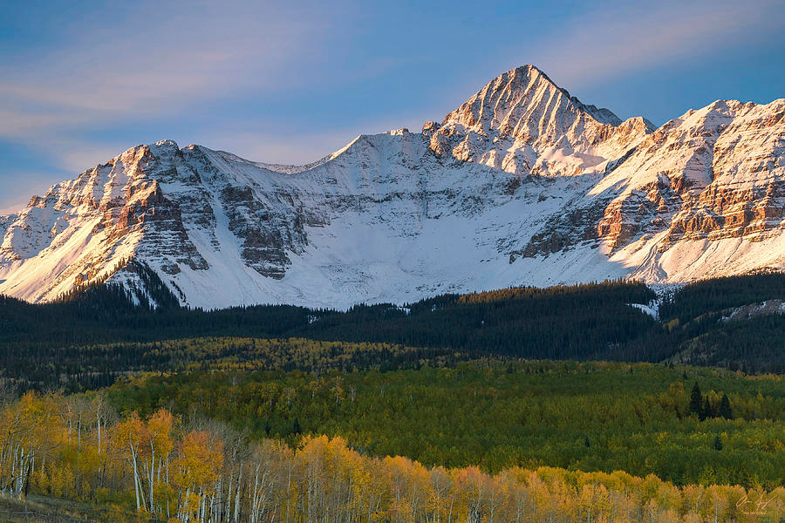
LIMBER Loan Fund
Colorado Loans to Increase Mainstreet Business Economic Recovery

Slide 2
Overview
The CLIMBER (Colorado Loans to Increase Mainstreet Business Economic Recovery) Loan Fund is a statewide program that will provide up to $250 million in working capital loans to Colorado small businesses. This public/private partnership is promoting small businesses recovery, save jobs, and help support the Colorado economy.

Slide 3
COVID-19 Economic Crisis
The global pandemic created by the COVID-19 respiratory virus in the spring of 2020, has caused a painful economic recession. Mandatory shut- and slow-downs of commerce are required to control the virus’ spread. Federal programs, while beneficial, were sized too small (estimated coverage in CO was 38% of the need). For example the PPP program, based only on two-and-a-half months of payroll, could only be used on payroll, rent/interest, and utilities. Many once successful small businesses will need additional working capital to move forward toward recovery.
This CLIMBER Loan Program is providing capital to help these once successful small businesses “climb” out of this recession and get back on the top of their sectors.

Slide 4
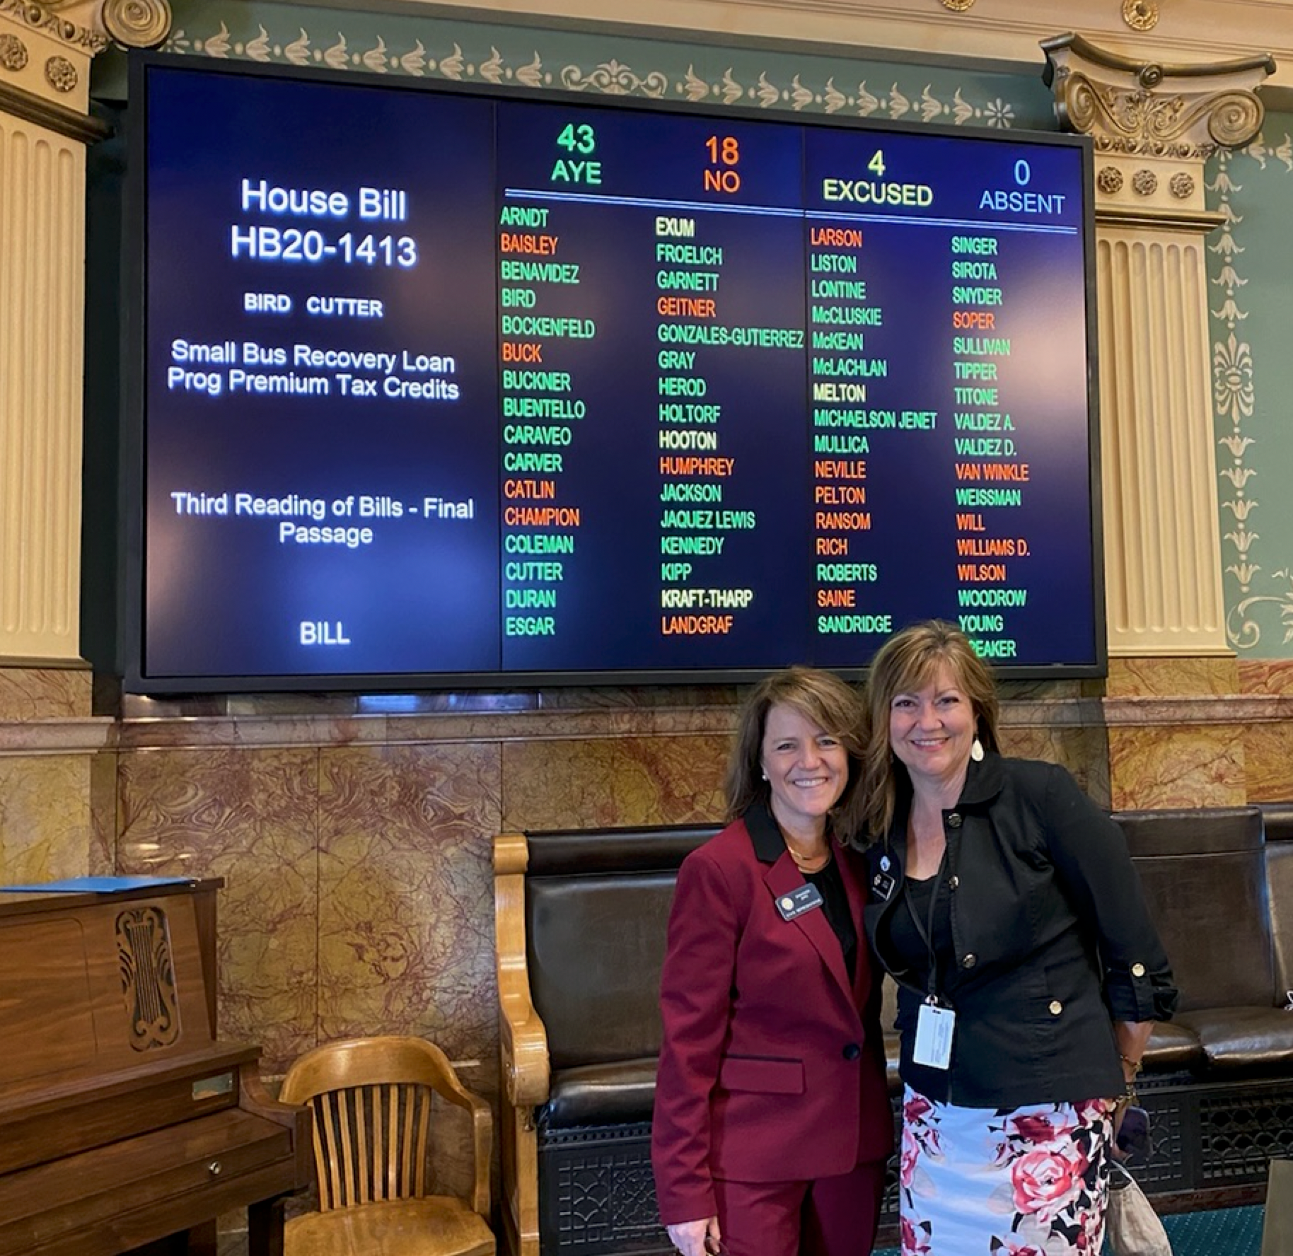
HB20-1413: The CLIMBER Act
The Governor’s Commission on Economic Stability and Growth recommended that the State create a large small business loan fund to address the ongoing needs of small businesses over the course of the next two years.
The legislature passed HB20-1413, the Colorado Loans to Increase Mainstreet Business Economic Recovery Act in June.
The program is run by the State Treasurer’s Office, with the support of the Governor’s Office of Economic Development and International Trade.
The CLIMBER Fund will be up to $250M
The State will contribute 20%, or $50M in first loss capital
The Fund is being capitalized in successive tranches of up to $50M

Slide 5
Additional Legislation
HB2022-1328 and HB2023-209
Decreased loan minimum loan size from $30,000 to $10,000
Decreased minimum employee count from 5 to 1
Changes requirement of two consecutive years of positive cash flow prior to February 29, 2020 to just one year at any time.
Allowed fundraising through the end of FY 2023-2024
Allow small business loans to be made until the end of FY 2027-28 instead of FY 2025-26
Allow for 10 year loans instead of limiting them to 5 years

Slide 6
Message from Governor Polis
“COVID 19 has created a statewide economic crisis that has hit small businesses particularly hard. The economic interruption has been widespread and businesses owned by traditionally underserved populations such as minorities, women, veteran and rural Coloradans have been further disadvantaged. To help our small businesses climb back and aid our economic recovery, Colorado’s public and private sectors have partnered to create innovative capital programs that serve the immediate and forward-looking needs of our small businesses. The CLIMBER Fund leverages $50M in state first loss capital to attract critical private investment dollars to increase our reach and aid our economic recovery. I wholeheartedly encourage private investors like our banks to consider joining the State of Colorado in supporting our economy, our communities, and our small businesses by investing in the CLIMBER fund. We are stronger together and I encourage our financial pillars to join us to help empower Colorado’s small businesses with the capital they need to serve our communities and retain our jobs.”

Slide 7
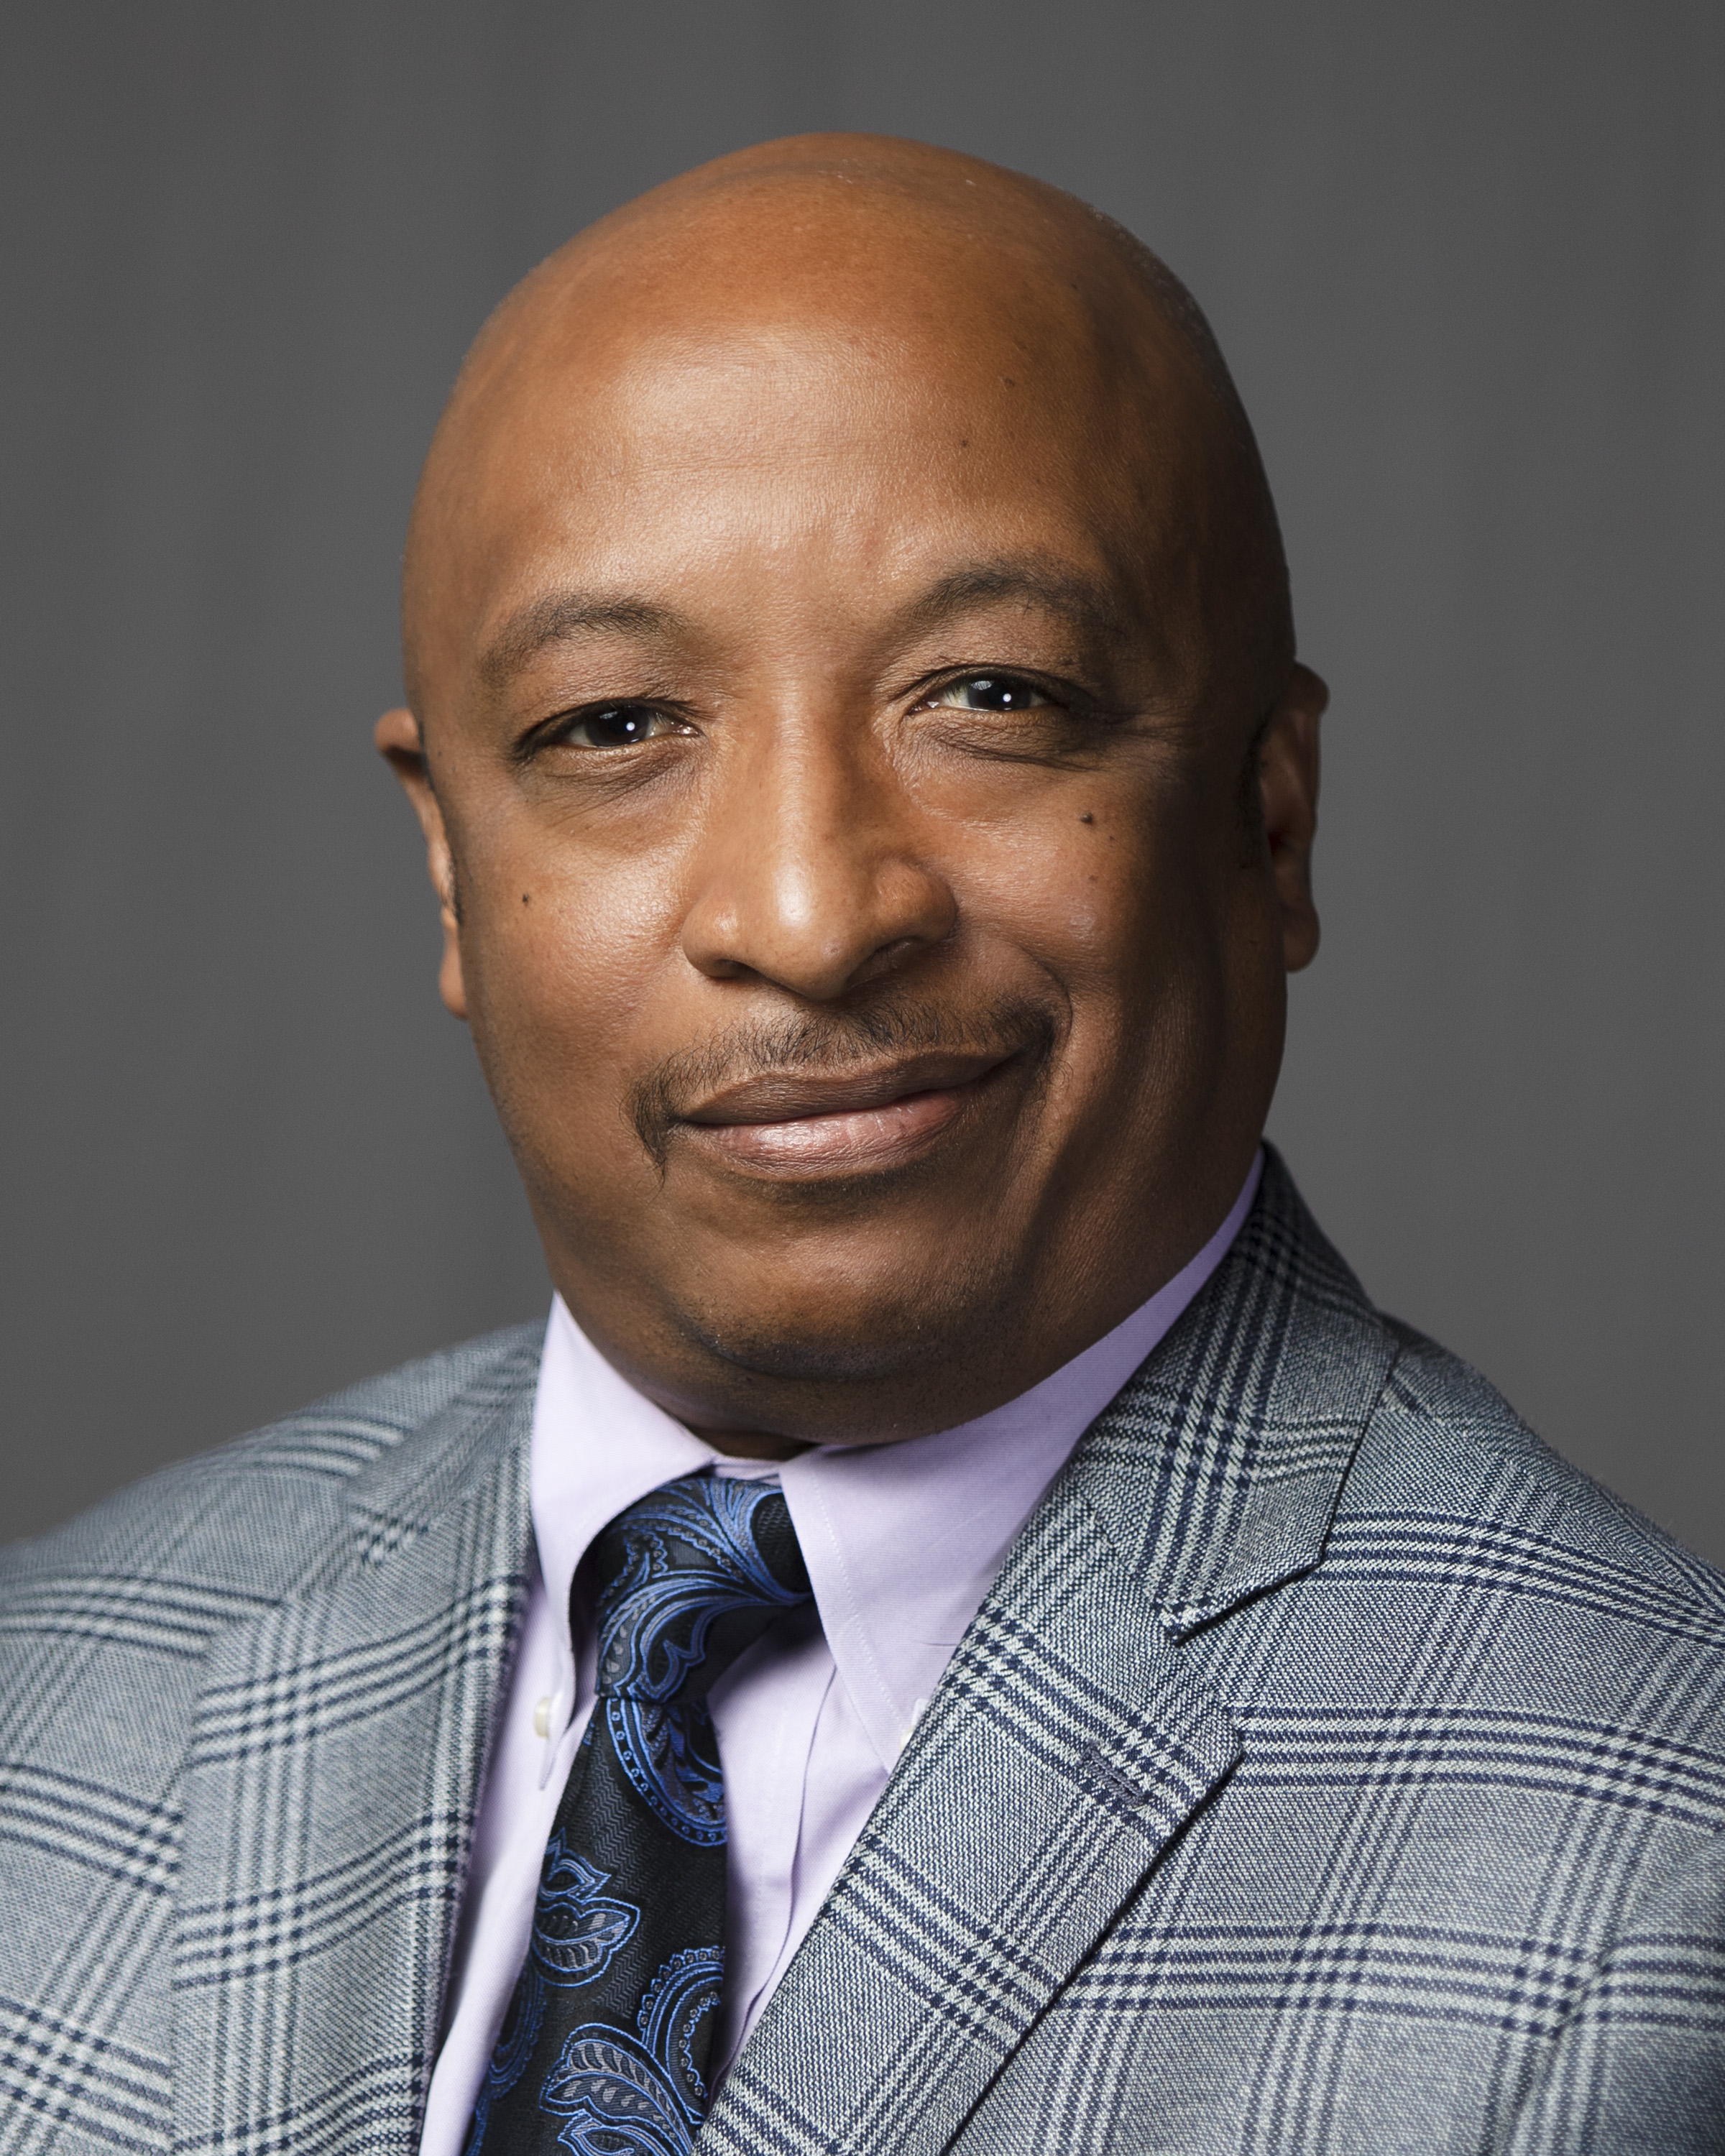
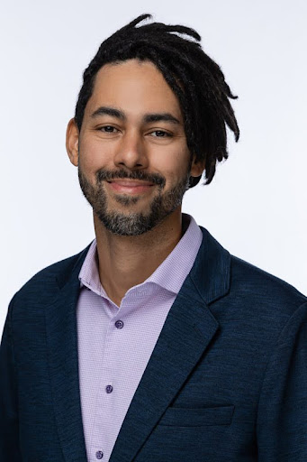
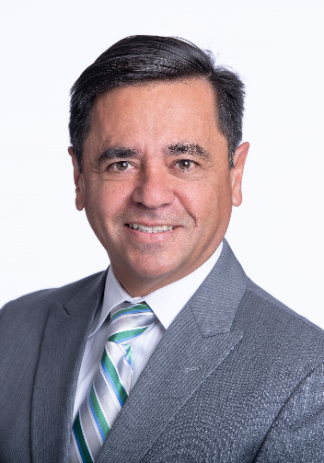
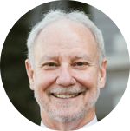
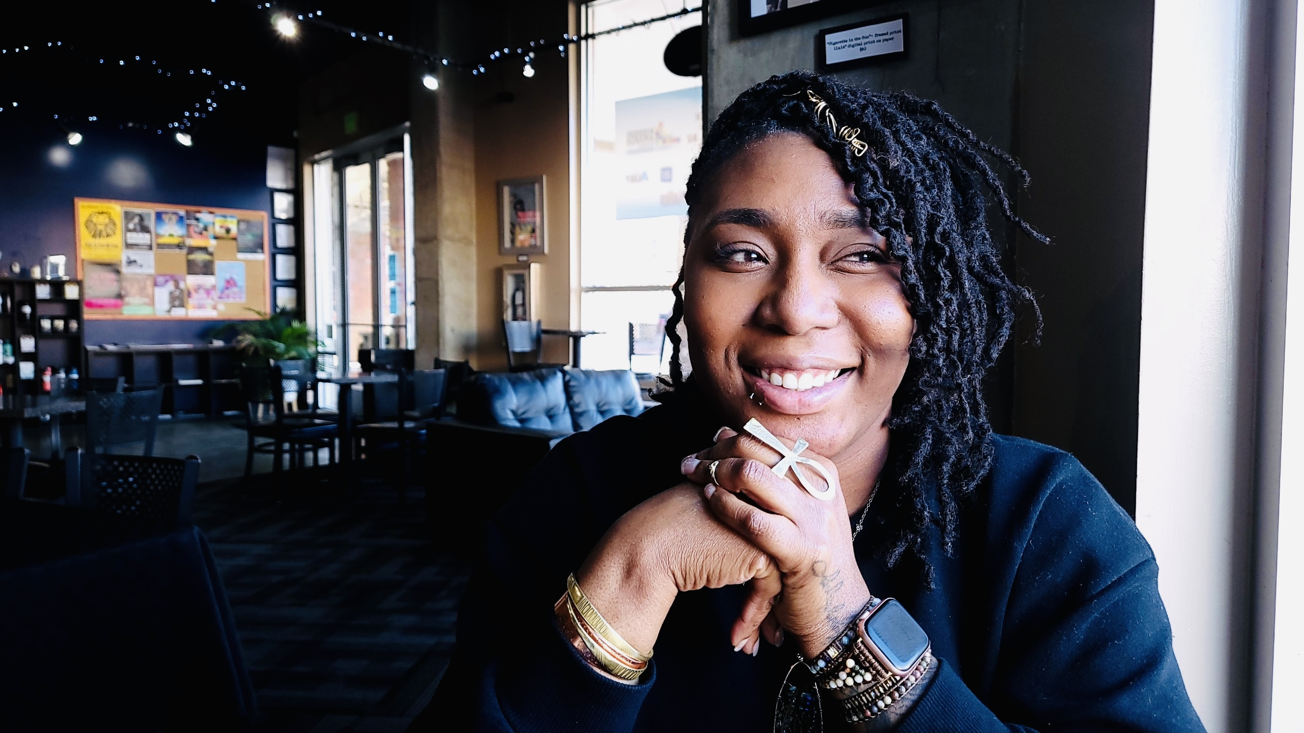
Current CLIMBER Governance Board
Dave Young, Chair Dianne Myles Malcolm Evans Tristan Watkins Bonifacio Sandoval
Colorado State Treasurer CEO Director Designee Sr. VP. Dope Mom Life WinTrust Bank Minority Business Office, OEDIT Adams Bank & Trust
The Program is governed by a 5-member Oversight Board. The board includes the State Treasurer, the director of the Minority Business Office in OEDIT, and three appointed members with executive-level experience in banking or capital markets (required by statute).

Slide 8
Former Board Members
Doug Price, Citizens State Bank
Akasha Absher, Syntrinsic Investment Council, LLC
Peter Calamari, Platte River Equity
Antonio Soto, Minority Business Office
Monique Lovato, Minority Business Office
Rosy McDonough, Minority Business Office

Slide 9
Fundraising Team
Original Fundraising Team
Kent Thiry
Former Executive Chairman, DaVita
Blair Richardson
Managing Director, Bow River Capital
Brad Feld
Managing Director, Foundry Group
Jim Kelley
Founding Partner, Vestar Capital
Peter Calamari
Managing Director, Platte River Equity
Current Fundraising Team
Jeff Kraft
OEDIT
Mary Wickersham
Social Impact Solutions
Harsha Sekar
Michael Best
Peter Calamari
Platte River Equity
Notes:
Do we want to delete this slide?

Slide 10
CLIMBER STAFF
Staff
At the start Mary Wickersham, Jeff Craft, and Sean Gould
2020-2022 Jim Eke
2023-2024 Sam Taylor

Slide 11
Fund Operation and loan products
The operation of the fund will maximize strong underwriting by appropriately aligning success incentives with originating lenders using three loan products:
Participation Loans
Credit Enhancement Products
Direct Lending by Nonprofit Lenders
“We want responsible borrowers. We want responsible lenders.”
--Rep. Shannon Bird, CLIMBER bill sponsor
--Denver Business Journal

Slide 12
Colorado Housing and Finance Authority
Strong CLIMBER loan program manager, Colorado Housing and Finance Authority (CHFA)
Experienced statewide small business financing support ($1.6 billion)
Active fund management, including managing for:
Compliance
Statutory
Board Policy
Impact targets
Financial—additional level of financial underwriting/oversight
Day to day management
Identifying and recruiting small business lenders
Investigating and underwriting lenders for the program
Collecting and remitting proceeds from loans
Overall fund financial stability

Slide 13
Business Targets
The program is designed to provide equitable access to capital for community development through small business across the state.
CLIMBER incentivizes loans to small businesses that:
Have fewer than 100 employees (additional prioritization for businesses with less than $1M in annual gross revenues)
Are in low-moderate income geographies
Are in distressed and underserved nonmetropolitan geographies
In addition, the CLIMBER program will deploy capital through CDFIs and other non-profit lenders.
The State, working with the State Banking Commissioner, has engaged regulators from the OCC and the Federal Reserve to receive input about CRA compliance, including identifying data that will be tracked and reported to lenders.

Slide 14
Business Requirements and Loan Terms
Qualifying businesses have:
Between 1-99 employees
One-year positive EBITDA
Debt service coverage ratio of at least 1:1 in the last five years
Key business loan terms include
below market interest rate ( 4%-6.32% set by the board for each tranche)
payment deferrals for up to one year
maturities of up to 10 years
loan sizes between $10K-$500K
Allocation and Prioritization
The program will make capital available to all 64 counties for initial period (unused portions then revert to the general pool).
Marketing for the program is targeting (based on benchmarks):
Women owned businesses
Minority owned businesses
Veteran owned businesses
Rural businesses
Businesses in low-to-moderate income areas
Businesses in distressed and underserved areas

Slide 15
Marketing and Brand Awareness
Two rounds of marketing by Kernel Core Messaging
2021
A mix of TV, radio, digital, and print in both Spanish and English
2023
Another mix of TV, radio, digital, and print in Spanish and English
Wide reach using Amazon partners

Slide 16
2022-2023 Media Campaign
Gross Impressions by Tactic
Television
Impressions English: 5,067,100 Impressions Spanish: 1,017,700
Budget English: $90,000 Budget Spanish: $37,000
Digital
Impressions: 3,941,418 Budget Digital: $45,000
Comcast/Dish
Impressions: 6,574,626 Budget Comcast/Dish: $86,000
Radio Ranked
Impressions: N/A Budget: $41,000
Radio Unranked
Impressions: N/A Budget: $20,600

Slide 17
Loan Fund
Each fundraising tranche is raised by a combination of 20% State funds and 80% contributor funds
State funds are from the sale of $50 million in tax credits to be used as first-loss funds and payment of fund expenses. These credits are redeemable by the buyers over the next 3 years.
80% is privately raised from Contributing banks in the form of loans.
Each tranche of funding has no minimum and with a maximum of $50 million total.

Slide 18
Tranche 1- $28.1 Million
State 20% Contribution $5.6 Million
Private Contributors $22.5 Million at 2%
Additional $3 million of State funds set aside for Credit Enhancement Products.
Contributors include Wells Fargo, Northern Trust, UMB, Key Bank, and FNBO

Slide 19
Tranche 2- $15 Million
State 20% Contribution- $3.0 Million
Private Contributors $10.5 Million at 2.5%
SSBCI Funds $1.5 Million
Contributors include Wells Fargo, Northern Trust, UMB, and FNBO

Slide 20
Upcoming Tranche 3
Three Separate Fundraising Products:
Master Funding Agreement (“MFA”) Fund Structure
Direct Investment with CDFI/Non-Profit Lender
CLIMBER Loan-Backed Security

Slide 21
Current Small Business Lenders
First Southwest Bank
First Southwest Community Fund
B:Side Capital
Bank of Colorado
Good Capital
Lendistry
Nuvista Federal Credit Union
Southern Colorado Community Lending
Energize Colorado
Colorado Clean Energy Fund

Slide 22
Impact So Far
The CLIMBER program continues to impact businesses, families and communities across the state. Early results include:
172 Small Business Loans
$41 Million Invested
1281 Jobs Supported and 101 Created
64 Loans to Minority Ownership, 75 to Women Owned Businesses, and 21 to Veteran Owned
Keeping businesses going and/or helping them reopen not only has the direct effect on the owners and employees but has a 1.5x multiplier effect in the state’s economy.

Slide 23
Questions?
Information and contact
www.CLIMBER-Colorado.com
Sam.e.Taylor@state.co.us

